Slide 1

The Mind-Body Problem
PH1102E, Week 9

Slide 2
Plan for Today
I. Mind: consciousness & cognition
II. Mind and brain
III. Two theories of consciousness
IV. The knowledge argument
V. Objections to the knowledge argument

Slide 3
I. Mind: Consciousness & cognition

Slide 5






Slide 6

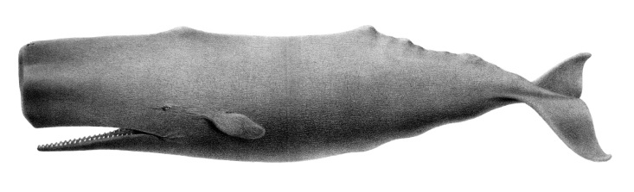




Slide 7
CONSCIOUSNESS
COGNITION

Slide 8
CONSCIOUSNESS
COGNITION

Slide 9
Aspects of Mind
Conscious
(related to feelings)
Feelings
Perceptual sensations (five senses)
Non-perceptual feelings (dizziness,
pain, fatigue, nausea, etc.)
Moods and emotions
Desire
Cognitive
(goal-setting and problem solving)
Thought
Memory
Learning
Language comprehension
Decision making
Desire

Slide 10
Aspects of Mind
Conscious
(related to feelings)
Sensations
Perceptual sensations (five senses)
Non-perceptual feelings (dizziness,
pain, fatigue, nausea, etc.)
Moods and emotions
Desire
Cognitive
(goal-setting and problem solving)
Thought
Memory
Learning
Language comprehension
Decision making
Desire

Slide 11
Aspects of Mind
Conscious
(related to feelings)
Sensations
Perceptual sensations (five senses)
Non-perceptual feelings (dizziness,
pain, fatigue, nausea, etc.)
Moods and emotions
Desire
Cognitive
(goal-setting and problem solving)
Thought
Memory
Learning
Language comprehension
Decision making
Desire

Slide 12
Aspects of Mind
Conscious
(related to feelings)
Sensations
Perceptual sensations (five senses)
Bodily sensations (dizziness,
pain, fatigue, nausea, etc.)
Moods and emotions
Desire
Cognitive
(goal-setting and problem solving)
Thought
Memory
Learning
Language comprehension
Decision making
Desire

Slide 13
Aspects of Mind
Conscious
(related to feelings)
Sensations
Perceptual sensations (five senses)
Bodily sensations (dizziness,
pain, fatigue, nausea, etc.)
Moods and emotions
Desire
Cognitive
(goal-setting and problem solving)
Thought
Memory
Learning
Language comprehension
Decision making
Desire

Slide 14
Aspects of Mind
Conscious
(related to feelings)
Sensations
Perceptual sensations (five senses)
Bodily sensations (dizziness,
pain, fatigue, nausea, etc.)
Moods and emotions
Desire
Cognitive
(goal-setting and problem solving)
Thought
Memory
Learning
Language comprehension
Decision making
Desire

Slide 15
Aspects of Mind
Conscious
(related to feelings)
Sensations
Perceptual sensations (five senses)
Bodily sensations (dizziness,
pain, fatigue, nausea, etc.)
Moods and emotions
Desire
Cognitive
(goal-setting and problem solving)
Thought
Memory
Learning
Language comprehension
Decision making
Desire

Slide 16
Aspects of Mind
Conscious
(related to feelings)
Sensations
Perceptual sensations (five senses)
Bodily sensations (dizziness,
pain, fatigue, nausea, etc.)
Moods and emotions
Desire
Cognitive
(goal-setting and problem solving)
Thought
Memory
Learning
Language comprehension
Decision making
Desire

Slide 18

?

Slide 21
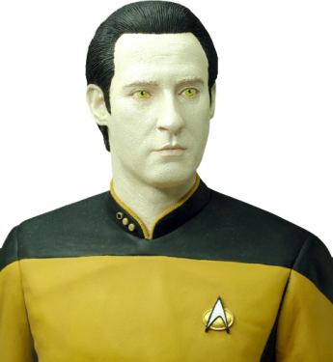
?

Slide 23
II. Mind & Brain

Slide 24
Mind & Brain

Slide 25
Mind & Brain
There are detailed correlations between the physical processes that take place in your brain, and the conscious experiences (feelings, sensations, moods, etc.) that you have.
This is a scientifically established fact that everyone agrees about.

Slide 26
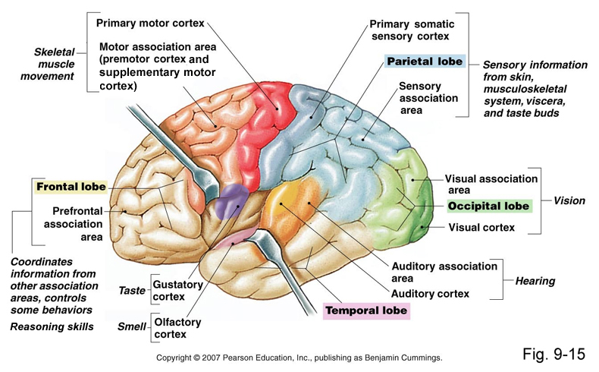

Slide 27
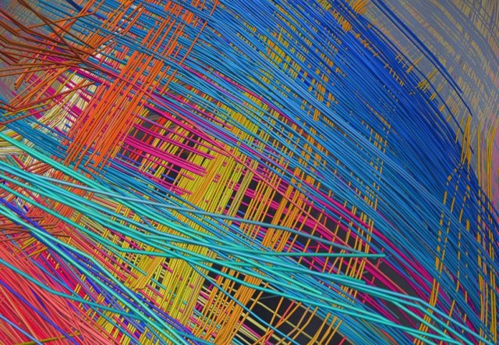

Slide 28
Mind & Brain
While everyone agrees that conscious experience correlates with brain activity, the nature of the correlation is hotly disputed.

Slide 29
Mind & Brain
While everyone agrees that conscious experience correlates with brain activity, the nature of the correlation is hotly disputed.
There are two main schools of thought on this subject: physicalism and dualism.

Slide 30
III. Two theories of Consciousness

Slide 31
Physicalism vs. Dualism
Physicalism:
Conscious experience is a purely physical phenomenon. Sensations = chemical reactions in your brain.
Dualism:
Conscious experience is not a purely physical phenomenon. Sensations are caused by, but not identical with, chemical reactions in your brain.

Slide 32
Physicalism vs. Dualism
Physicalism:
Conscious experience is a purely physical phenomenon. Sensations = chemical reactions in your brain.
Dualism:
Conscious experience is not a purely physical phenomenon. Sensations are caused by, but not identical with, chemical reactions in your brain.

Slide 33
Physicalism vs. Dualism
Physicalism:
Conscious experience is a purely physical phenomenon. Sensations = chemical reactions in your brain.
Dualism:
Conscious experience is not a purely physical phenomenon. Sensations are caused by, but not the same as, chemical reactions in your brain.

Slide 34
Physicalism
Physicalists say that the correlation between consciousness and brain chemistry is like the correlation between water and H₂O, or between pressure and molecular motion: i.e., it is a case of identity.

Slide 35
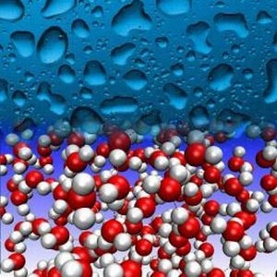
Physicalism
Water = H₂O
The presence of water is perfectly correlated with the presence of H₂O. This is because water just is H₂O: “water” and “H₂O” are two terms for the same thing.

Slide 36
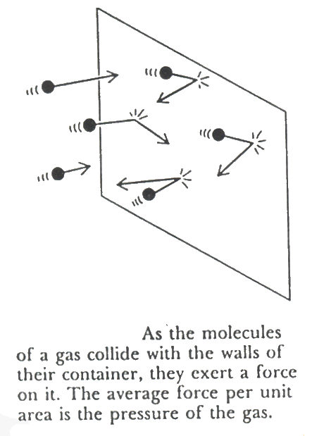
Physicalism
Pressure = molecular motion
There is a perfect correlation between the pressure of a gas and the average motion of the gas’s constituent molecules. This is because pressure just is the motion of molecules (average molecular kinetic energy).

Slide 37
Physicalism
To put it crudely, a physicalist says that just as pressure is nothing but the motion of molecules in a container of gas, consciousness is nothing but the motion of molecules in a brain.
For instance, a feeling of euphoria is just a release of endorphins by your hypothalamus. “Euphoria” and “hypothalamic endorphin secretion” are two terms for the same thing, like “water” and “H₂O.”
Notes:
So you could take a picture...
37

Slide 38

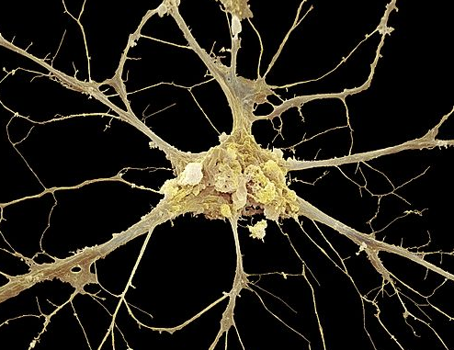
My Euphoria

Slide 39
Dualism
It is true that euphoria perfectly correlates with the secretion of endorphins, and other sensations correlate perfectly with other physical brain-processes.
Still, the euphoria and the endorphin secretion are different things.
The feeling is not the same thing as the secretion of endorphins; rather, the secretion causes the feeling.

Slide 40

smoke ≠ fire
There is a correlation between smoke and fire.
But it makes no sense to equate smoke with fire.
Rather, the fire causes the smoke.

Slide 41
Dualism
Just as smoke is a mere result or effect of fire, so too conscious experience is a mere result or effect of brain chemistry.
It makes no more sense to equate conscious experiences with chemical secretions than to equate smoke with fire.

Slide 42
Physicalism vs. Dualism
The Physicalist Picture:
environment
The Dualist Picture:
environment

Slide 43
Physicalism vs. Dualism
The Physicalist Picture:
environment → changes in sense organs
The Dualist Picture:
environment → changes in sense organs

Slide 44
Physicalism vs. Dualism
The Physicalist Picture:
environment → changes in sense organs → brain event
The Dualist Picture:
environment → changes in sense organs → brain event

Slide 45
Physicalism vs. Dualism
The Physicalist Picture:
environment → changes in sense organs → brain event
The Dualist Picture:
environment → changes in sense organs → brain event → conscious experience

Slide 46
Physicalism vs. Dualism
The Physicalist Picture:
environment → changes in sense organs → brain event
The Dualist Picture:
environment → changes in sense organs → brain event → conscious experience
This is not a physical event.

Slide 47
Physicalism vs. Dualism
The Physicalist Picture:
environment → changes in sense organs → brain event
conscious experience
The Dualist Picture:
environment → changes in sense organs → brain event → conscious experience
This is not a physical event.
=

Slide 48
IV. The knowledge argument against physicalism

Slide 49
The Knowledge Argument
You could know everything about the physical nature of some creature, and yet not know everything about that creature’s conscious experience.
If physicalism were true, this would be impossible.
So, physicalism is false.

Slide 50
The Knowledge Argument
You could know everything about the physical nature of some creature, and yet not know everything about that creature’s conscious experience.
If physicalism were true, this would be impossible.
So, physicalism is false.

Slide 51
“You could know everything about the physical nature of some creature, and yet not know everything about that creature’s conscious experience.”
Suppose you knew everything about the physical nature of a bat:
its gross physical traits (weight, girth, color, wingspan, etc.)
its anatomy (including the microscopic structure of its eyes,
ears, brain, etc.)
the electrical, chemical, and mechanical processes that
occur in the cells of which the bat is composed
its genetic code
its behavior (flying patterns, eating habits, metabolism, etc.)
the atomic structure of each organelle in the bat’s body

Slide 52
“You could know everything about the physical nature of some creature, and yet not know everything about that creature’s conscious experience.”
Suppose you knew everything about the physical nature of a bat:
its gross physical traits (weight, girth, color, wingspan, etc.)
its anatomy (including the microscopic structure of its eyes,
ears, brain, etc.)
the electrical, chemical, and mechanical processes that
occur in the cells of which the bat is composed
its genetic code
its behavior (flying patterns, eating habits, metabolism, etc.)
the atomic structure of each organelle in the bat’s body

Slide 53
“You could know everything about the physical nature of some creature, and yet not know everything about that creature’s conscious experience.”
Suppose you knew everything about the physical nature of a bat:
its gross physical traits (weight, girth, color, wingspan, etc.)
its anatomy (including the microscopic structure of its eyes,
ears, brain, etc.)
the electrical, chemical, and mechanical processes that
occur in the cells of which the bat is composed
its genetic code
its behavior (flying patterns, eating habits, metabolism, etc.)
the atomic structure of each organelle in the bat’s body

Slide 54
“You could know everything about the physical nature of some creature, and yet not know everything about that creature’s conscious experience.”
Suppose you knew everything about the physical nature of a bat:
its gross physical traits (weight, girth, color, wingspan, etc.)
its anatomy (including the microscopic structure of its eyes,
ears, brain, etc.)
the electrical, chemical, and mechanical processes that
occur in the cells of which the bat is composed
its genetic code
its behavior (flying patterns, eating habits, metabolism, etc.)
the atomic structure of each organelle in the bat’s body

Slide 55
“You could know everything about the physical nature of some creature, and yet not know everything about that creature’s conscious experience.”
Suppose you knew everything about the physical nature of a bat:
its gross physical traits (weight, girth, color, wingspan, etc.)
its anatomy (including the microscopic structure of its eyes,
ears, brain, etc.)
the electrical, chemical, and mechanical processes that
occur in the cells of which the bat is composed
its genetic code
its behavior (flying patterns, eating habits, metabolism, etc.)
the atomic structure of each organelle in the bat’s body

Slide 56
“You could know everything about the physical nature of some creature, and yet not know everything about that creature’s conscious experience.”
Suppose you knew everything about the physical nature of a bat:
its gross physical traits (weight, girth, color, wingspan, etc.)
its anatomy (including the microscopic structure of its eyes,
ears, brain, etc.)
the electrical, chemical, and mechanical processes that
occur in the cells of which the bat is composed
its genetic code
its behavior (flying patterns, eating habits, metabolism, etc.)
the atomic structure of each organelle in the bat’s body

Slide 57
“You could know everything about the physical nature of some creature, and yet not know everything about that creature’s conscious experience.”
Suppose you knew everything about the physical nature of a bat:
its gross physical traits (weight, girth, color, wingspan, etc.)
its anatomy (including the microscopic structure of its eyes,
ears, brain, etc.)
the electrical, chemical, and mechanical processes that
occur in the cells of which the bat is composed
its genetic code
its behavior (flying patterns, eating habits, metabolism, etc.)
the atomic structure of each organelle in the bat’s body

Slide 58
“You could know everything about the physical nature of some creature, and yet not know everything about that creature’s conscious experience.”
Suppose you knew everything about the physical nature of a bat:
its gross physical traits (weight, girth, color, wingspan, etc.)
its anatomy (including the microscopic structure of its eyes,
ears, brain, etc.)
the electrical, chemical, and mechanical processes that
occur in the cells of which the bat is composed
its genetic code
its behavior (flying patterns, eating habits, metabolism, etc.)
the atomic structure of each organelle in the bat’s body

Slide 59
“You could know everything about the physical nature of some creature, and yet not know everything about that creature’s conscious experience.”
Knowing all this, would you now know everything about the bat?
Would you know what it is like to have the kinds of experiences a bat has when it navigates through its environment using its sense of echo-location?

Slide 60
“You could know everything about the physical nature of some creature, and yet not know everything about that creature’s conscious experience.”
Knowing all this, would you now know everything about the bat?
Would you know what it is like to have the kinds of experiences that the bat has when it navigates through its environment using its sense of echo-location?

Slide 61
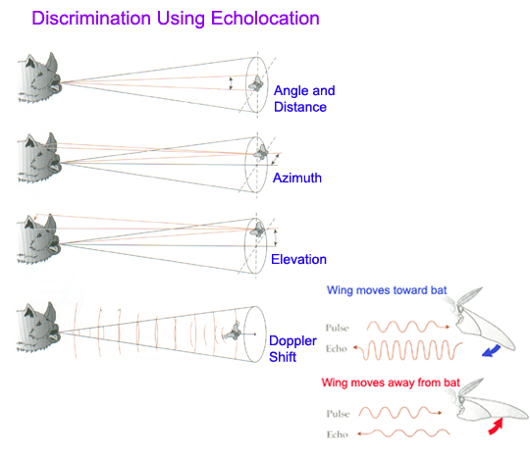
“You could know everything about the physical nature of some creature, and yet not know everything about that creature’s conscious experience.”
Bats use a form of biological sonar to “hear” objects within range (including, but not limited to, insects and other flying objects).

Slide 62
“You could know everything about the physical nature of some creature, and yet not know everything about that creature’s conscious experience.”
Despite knowing everything about the physical nature of bats, you still do not know what it is like to have the kinds of experiences a bat has when it perceives its surroundings using echolocation.

Slide 63
“You could know everything about the physical nature of some creature, and yet not know everything about that creature’s conscious experience.”

Slide 64
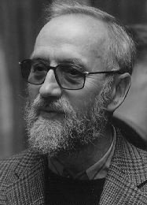
“You could know everything about the physical nature of some creature, and yet not know everything about that creature’s conscious experience.”
Frank Jackson,
Sometime Dualist

Slide 65
“You could know everything about the physical nature of some creature, and yet not know everything about that creature’s conscious experience.”
Mary is a brilliant scientist who has devoted her entire life to studying the physical basis of human vision.
She knows all about human eyes and human brains, and all about how exposure to light of different wavelengths and intensities leads to various microphysical events in the retina, optical nerves, and occipital lobe.
Frank Jackson,
Sometime Dualist

Slide 66
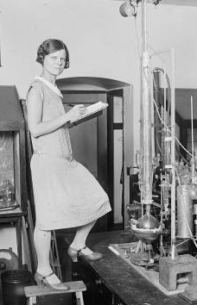
“You could know everything about the physical nature of some creature, and yet not know everything about that creature’s conscious experience.”
But Mary has acquired all of this information while working inside a high-tech laboratory/prison in which the only colors are black, white, and shades of gray.
She has never been outside of this facility, although she is free to communicate with people from outside via telephone, radio, and black-and-white video relay.

Slide 67
“You could know everything about the physical nature of some creature, and yet not know everything about that creature’s conscious experience.”
But Mary has acquired all of this information while working inside a high-tech laboratory/prison in which the only colors are black, white, and shades of gray.
She has never been outside of this facility, although she is free to communicate with people from outside via telephone, radio, and black-and-white video relay.

Slide 68


Slide 69
“You could know everything about the physical nature of some creature, and yet not know everything about that creature’s conscious experience.”
Does Mary learn anything when she sees the tomato -- the first colorful object she has ever encountered?

Slide 70
“You could know everything about the physical nature of some creature, and yet not know everything about that creature’s conscious experience.”
Does Mary learn anything when she sees the tomato -- the first colorful object she has ever encountered?
Yes!

Slide 71
“You could know everything about the physical nature of some creature, and yet not know everything about that creature’s conscious experience.”
Does Mary learn anything when she sees the tomato -- the first colorful object she has ever encountered?
Yes!
She learns what it is like to see something red.

Slide 72
Prior to seeing the tomato, she didn’t know whether seeing it would be like...

Slide 74


Slide 75


Slide 76
“You could know everything about the physical nature of some creature, and yet not know everything about that creature’s conscious experience.”
And this is despite the fact that she already knew in advance exactly what physical events would take place in her eyes and brain when she saw the tomato.

Slide 77
The Knowledge Argument
You could know everything about the physical nature of some creature, and yet not know everything about that creature’s conscious experience.
If physicalism were true, this would be impossible.
So, physicalism is false.

Slide 78
The Knowledge Argument
❐
You could know everything about the physical nature of some creature, and yet not know everything about that creature’s conscious experience.
If physicalism were true, this would be impossible.
So, physicalism is false.

Slide 79
The Knowledge Argument
❐
You could know everything about the physical nature of some creature, and yet not know everything about that creature’s conscious experience.
If physicalism were true, this would be impossible.
So, physicalism is false.
?

Slide 80
If physicalism were true, it would be impossible to know everything about the physical nature of some creature, and yet not know everything about that creature’s conscious experience.

Slide 81
If physicalism were true, it would be impossible to know everything about the physical nature of some creature, and yet not know everything about that creature’s conscious experience.
Physicalism says that a creature’s conscious experiences are just an aspect of the creature’s physical nature (chemical reactions in the creature’s brain, or whatnot).
So if physicalism is true, there’s no way to know everything about a creature’s physical nature without knowing everything about its conscious experiences.

Slide 82
If physicalism were true, it would be impossible to know everything about the physical nature of some creature, and yet not know everything about that creature’s conscious experience.
Physicalism says that a creature’s conscious experiences are just an aspect of the creature’s physical nature (chemical reactions in the creature’s brain, or whatnot).
So if physicalism is true, there’s no way to know everything about a creature’s physical nature without knowing everything about its conscious experiences.

Slide 83
The Knowledge Argument
❐
You could know everything about the physical nature of some creature, and yet not know everything about that creature’s conscious experience.
If physicalism were true, this would be impossible.
So, physicalism is false.
?

Slide 84
The Knowledge Argument
❐
You could know everything about the physical nature of some creature, and yet not know everything about that creature’s conscious experience.
If physicalism were true, this would be impossible.
So, physicalism is false.
❐

Slide 85
The Knowledge Argument
❐
You could know everything about the physical nature of some creature, and yet not know everything about that creature’s conscious experience.
If physicalism were true, this would be impossible.
So, physicalism is false.
❐
!

Slide 86
V. Objections and replies

Slide 87
Today, we consider two objections to the knowledge argument.
Both are directed at the first premise of the argument, which states that you could know all of a creature’s physical characteristics without knowing everything about its conscious experiences.

Slide 88
Ability Objection
It is true that we, with our limited information, cannot imagine what it is like to have a bat’s experiences.
It is also true that an ordinary colorblind person does not know what it is like to see in color.

Slide 89
Ability Objection
OK, Mary does “learn” something when she sees the tomato. But only in the sense that she acquires a new ability.
Before she saw the tomato, Mary couldn’t imagine red things (unlike normal, unimprisoned, non-color blind folks).
Mary gains some know-how, but she acquires no new information (about colors, minds, or anything else).

Slide 90
Ability Objection
OK, Mary does “learn” something when she sees the tomato. But only in the sense that she acquires a new ability.
Before she saw the tomato, Mary couldn’t imagine red things (unlike normal, unimprisoned, non-color blind folks).
Mary gains some know-how, but she acquires no new information (about colors, minds, or anything else).
Notes:
Distinguish between practical and theoretical knowledge.
90

Slide 91
Ability Objection
OK, Mary does “learn” something when she sees the tomato. But only in the sense that she acquires a new ability.
Before she saw the tomato, Mary couldn’t imagine red things (unlike normal, unimprisoned, non-color blind folks).
Mary gains some know-how, but she acquires no new information (about colors, minds, or anything else).

Slide 92
Ability Objection
OK, Mary does “learn” something when she sees the tomato. But only in the sense that she acquires a new ability.
Before she saw the tomato, Mary couldn’t imagine red things (unlike normal, unimprisoned, non-color blind folks).
What Mary gains is just some new know-how, not some new information (about visual experience).
Notes:
92

Slide 93
Dualist’s Reply
The ability to imagine red is unnecessary for knowing what it’s like to see red.
Even if Mary never gains the ability to imagine red things, she still knows what it’s like to see red things when she sees them.

Slide 94
Dualist’s Reply
Before seeing the tomato, Mary is missing more than just the ability to imagine red.
Even if Mary never gains the ability to imagine red things, she still knows what it’s like to see red things when she sees them.

Slide 95
Dualist’s Reply
Before seeing the tomato, Mary is missing more than just the ability to imagine red.
After all, even if Mary never gains the ability to imagine red things, she’ll still learn what it’s like to see red things when she sees the tomato.

Slide 97
“Knowing what it’s like” objection
It is true that when Mary sees the tomato (her first colorful object), she learns something: she learns what it is like to have a red experience.
The dualists account for this by saying that when Mary sees the tomato, she has her first red experience, and, as a result, learns what it is like to have red experience.

Slide 98
“Knowing what it’s like” objection
This statement:
(1) “Mary knows what it’s like to see red.”
is simply synonymous with this statement:
(2) “Mary has seen red.”
The truth of (2) doesn’t explain the truth of (1). Rather, (1) and (2) are the same truth stated in different ways.

Slide 99
“Knowing what it’s like” objection
So it’s true that Mary didn’t know what it was like to see red, until she saw the tomato.
But that just means that Mary never had a sensation of red, until she saw the tomato.
When Mary sees the tomato, she gets a new sensation, but no new information---no knowledge of new facts.
So we can say that Mary already had all the information (knew all the facts) about color vision, even before she had any colorful experiences.

Slide 100
Dualist’s Reply

Slide 101
Dualist’s Reply
The statement (1) “Mary knows what it’s like to see red” is not synonymous with the statement (2) “Mary has seen red.”
If Mary never has another color experience after the tomato, she might eventually forget that she had the tomato experience.
In that case, (2) will be true, and (1) false, proving that (1) and (2) are not synonymous.

Slide 102
Physicalist’s Rejoinder
But the claim that “when Mary has her first red experience, she gains some information about the world” is precisely what I deny!
She does not gain any new information: she merely has a new kind of experience.
Having this new experience may be said to be “enlightening,” in the sense that it adds a new dimension to her life, but not in the sense that it adds a new datum to her existing stock of information.

Slide 103
Physicalist’s Rejoinder
PH2241: Philosophy of Mind
PH3241: Consciousness

Slide 104
End of lecture.

Slide 105
Weekly Assignment #8
In the reading for next week, John Searle argues that it is impossible for a digital computer to think. Yet Searle also says that if you could build a machine that had the same causal structure as a human being, then that machine would be able to think. How can Searle reconcile these statements?
Limit: 200 words.
Upload by 8pm, Thursday, 16 October 2014.

